Slide 1
Life Expectancy Analysis
INDHARAJITH G
DADS JUNE BATCH 2025
Date : 18.08.2025

Slide 2

Introduction
Life expectancy is one of the most important indicators of a country’s overall health and development.
It reflects the average number of years a newborn is expected to live if current health, education, and economic conditions remain constant.
Various socio-economic, environmental, and healthcare-related factors influence life expectancy
Key Objectives:
Understand the dataset structure and its attributes.
Handle missing values, outliers, and invalid data.
Perform descriptive, univariate, bivariate, and multivariate analysis.
Identify the strongest predictors of life expectancy

Slide 3
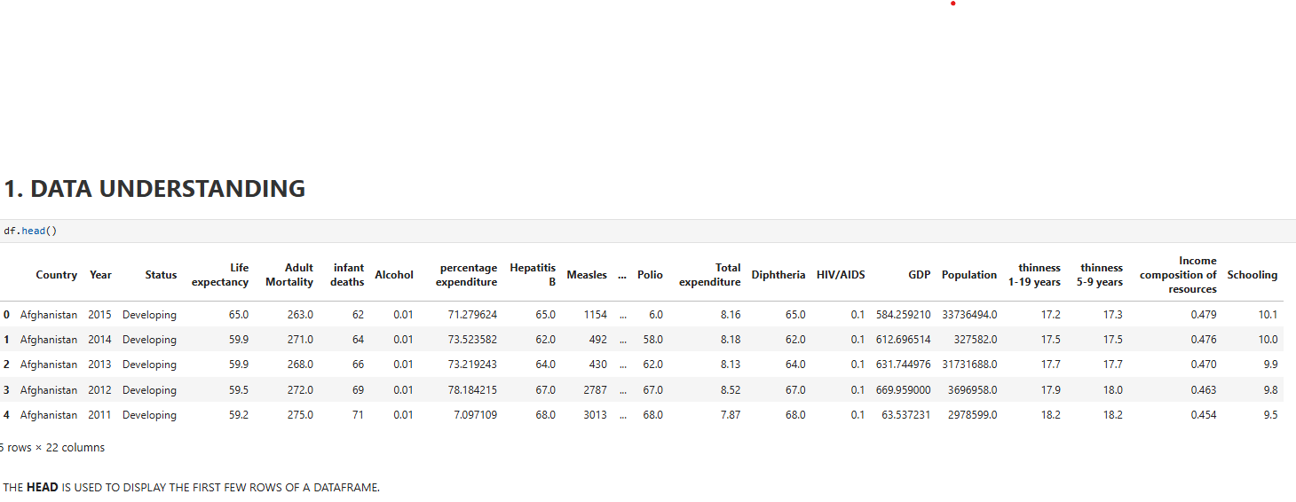
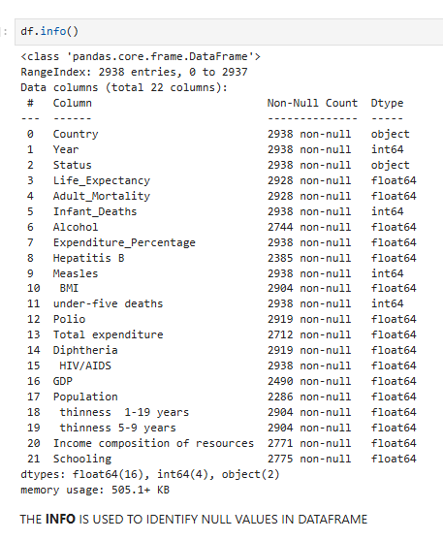
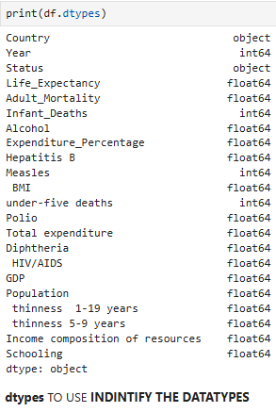
Data Understanding
Dataset Overview:
Source: WHO, UN, World Bank.
Size: 2938 rows × 22 columns (2000–2015, 190+ countries).
Includes both numerical (GDP, Mortality, BMI) and categorical (Country, Status) variables.
Key Variables:
Life Expectancy – average years at birth.
Adult & Infant Mortality – survival indicators.
Schooling – mean years of education.
GDP & Health Expenditure – economic indicators.
Immunization Coverage (Hepatitis B, Polio, Diphtheria) – healthcare quality.
HIV/AIDS, Measles, Thinness – disease & nutrition indicators.

Slide 4
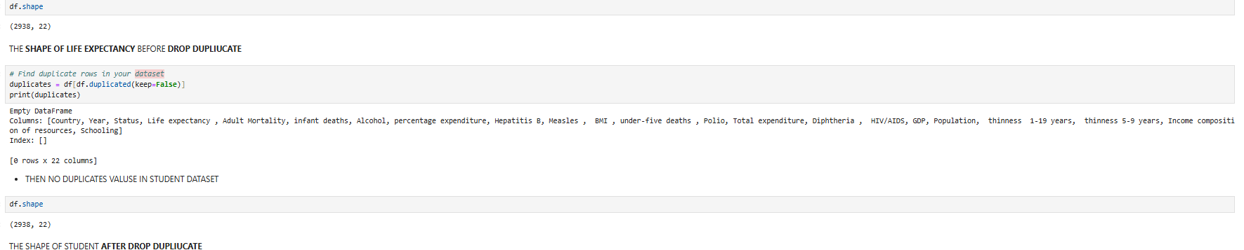
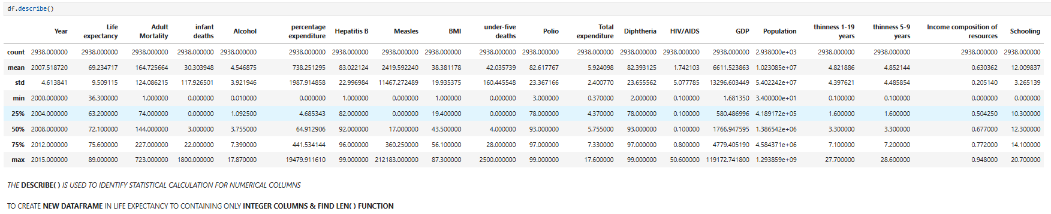
Data Cleaning
The raw dataset had inconsistent column names, missing entries, and some invalid values.
Cleaning was necessary to make it usable for analysis.
Steps Applied:
Column Renaming
Removed spaces and standardized names.
Example: "Life expectancy " → Life_Expectancy.
Data Type Checks
Converted numerical columns (GDP, Mortality, BMI) to proper numeric format.
Verified categorical fields (Country, Status).
Duplicates Removal
Checked for duplicate rows; none significant were found.
Standardization
Unified formats (e.g., years as integers).
Brought variables into consistent units.

Slide 5
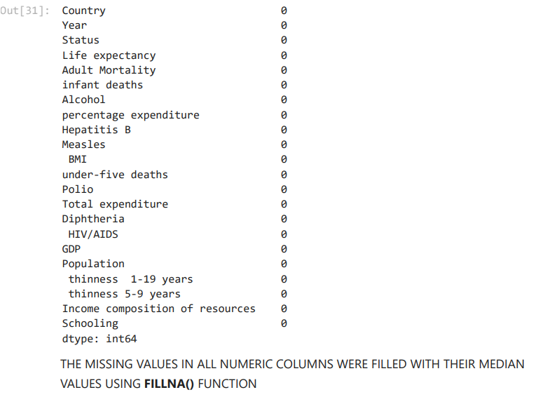
Handling Missing Values
Missing values can bias results and reduce accuracy.
Several columns in this dataset had null or blank entries.
Missing Values Occurred:
Life_Expectancy – some years missing for certain countries.
Adult_Mortality, BMI, GDP, Schooling – incomplete entries.
Immunization Coverage (Hepatitis B, Polio, Diphtheria) – gaps in developing nations.
Techniques Applied:
Imputation
Used Mean/Median values for continuous variables (e.g., BMI, GDP).
Used Mode/Most frequent for categorical-like values (e.g., Status).
Forward/Backward Fill
For time-series data (e.g., missing life expectancy across years for a country).
Row/Column Removal
Removed rows only when too many fields were missing (rare).

Slide 6
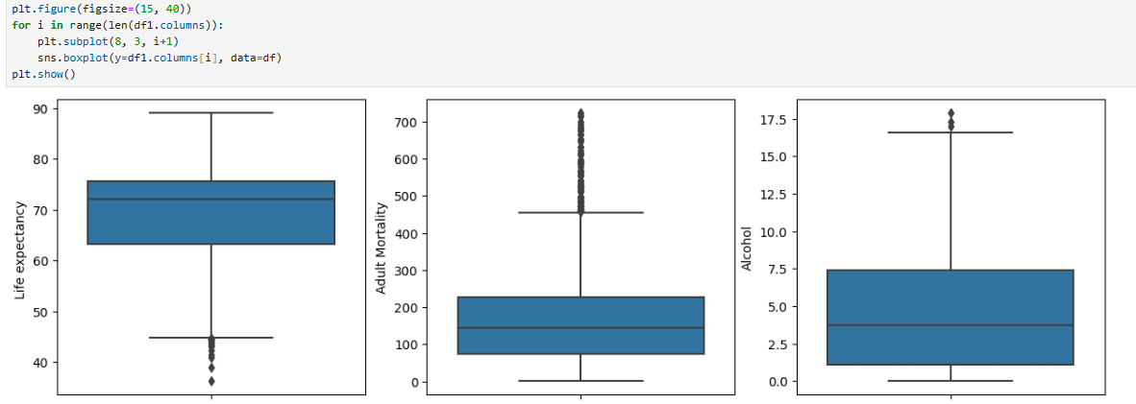
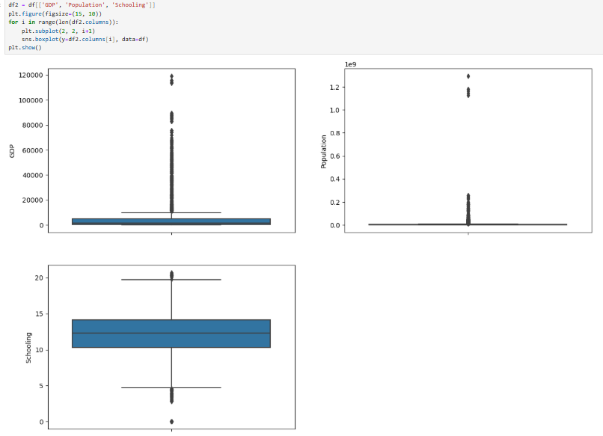
Outlier Handling
Outliers can distort averages and mislead statistical models.
In health-related data, extreme values may be due to reporting errors or rare conditions.
Techniques Applied:
Boxplots & Visual Detection
Used plots to spot extreme values in Life Expectancy, Mortality, and BMI.
Statistical Methods
Z-score method → flagged values beyond ±3 standard deviations.
IQR method → identified values outside 1.5×IQR range.
Treatment
Replaced unrealistic values with median (e.g., BMI, mortality).
Capped extreme GDP values at upper limits to reduce skew.
Removed very few records where values were completely invalid.

Slide 7
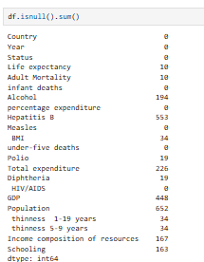
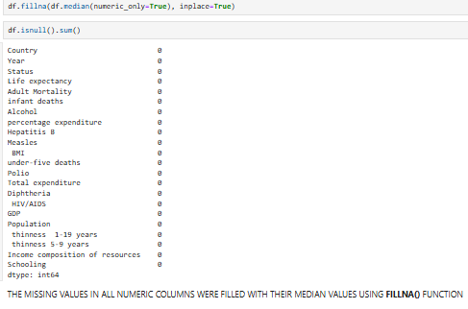
Handling Invalid Values
Invalid values (e.g., negative mortality rates, zero schooling years) are unrealistic and reduce reliability.
Must be corrected or removed before analysis.
Techniques Applied:
Replaced Impossible Values
Negative and zero values were replaced with NaN.
Imputation
Filled NaN with median values of similar countries/regions.
For schooling, used regional averages where missing.
Cross-Validation
Ensured values were in realistic ranges (e.g., Life Expectancy 30–90 years, BMI > 10).
Examples of Invalid Values Found:
Life_Expectancy – values missing or unusually low (below 20 years).
Adult_Mortality – negative entries in a few cases.
BMI – zero values, which are biologically impossible.
GDP & Schooling – zeros or blanks in some records.

Slide 8
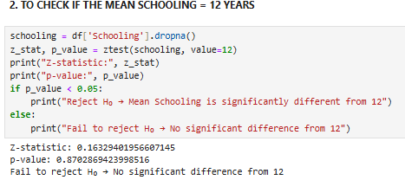
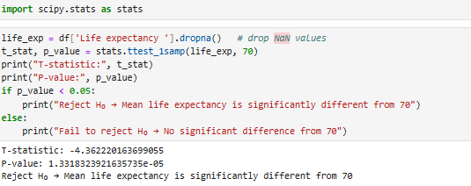
Statistical Analysis
Summarize data using descriptive measures and explore relationships between variables.
Key Observations:
Life Expectancy: Average ~70 years, ranging between 30–90 years.
GDP: Highly skewed, with a few very rich countries raising the mean.
Schooling: Mean ~11 years, strongly correlated with life expectancy.
Adult Mortality & Infant Deaths: Inversely related to life expectancy.
Descriptive Statistics Applied:
Measures of Central Tendency: Mean, Median, Mode of Life Expectancy, GDP, Schooling.
Dispersion: Standard deviation, Variance, Minimum & Maximum.
Distribution Checks: Skewness & Kurtosis for continuous variables.

Slide 9
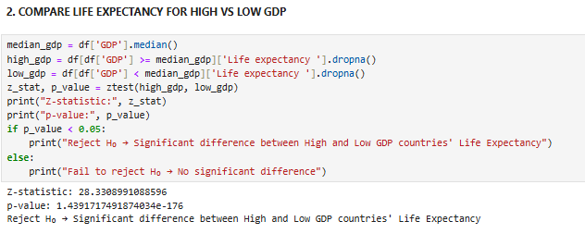
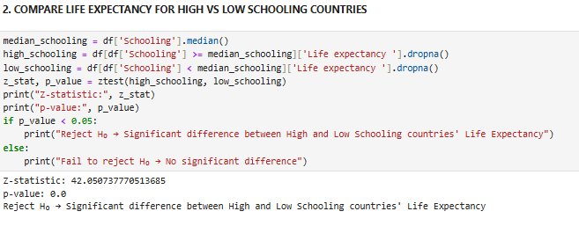
Descriptive Analysis
Purpose:
To explore and summarize the dataset visually & statistically.
Helps understand distributions and general trends.
Key Insights:
Life Expectancy:
Range: ~30 to 90 years.
Average: ~70 years.
Developed countries cluster at higher values (>75 years).
Mortality Indicators:
Adult Mortality & Infant Deaths much higher in developing nations.
Strong inverse effect on Life Expectancy.
Economic & Social Indicators:
GDP distribution highly skewed (few rich countries, many low-GDP).
Schooling: Higher years strongly linked to longer lifespan.
Health Factors:
Immunization Coverage (Polio, Diphtheria, Hepatitis B) is near 100% in developed nations but inconsistent in developing ones.
HIV/AIDS deaths reduce Life Expectancy sharply in affected countries.

Slide 10
Relationships Between Variables
Purpose:
To analyze how socio-economic and health factors influence Life Expectancy.
Positive Relationships (Life Expectancy ↑ when factor ↑):
GDP – Richer countries show longer lifespans.
Schooling – More years of education = better health outcomes.
Immunization Coverage (Hepatitis B, Polio, Diphtheria) – Higher coverage improves survival rates.
Income Composition of Resources – Higher equality leads to longer life expectancy.
Negative Relationships (Life Expectancy ↓ when factor ↑):
Adult Mortality – Higher mortality sharply reduces life expectancy.
Infant & Under-Five Deaths – Direct negative impact on lifespan averages.
HIV/AIDS deaths – Strong inverse effect, especially in developing nations.
Thinness (Children & Adolescents) – Malnutrition contributes to lower life expectancy.
Correlation Insights:
Strong Positive: Life Expectancy ↔ Schooling, GDP.
Strong Negative: Life Expectancy ↔ Adult Mortality, HIV/AIDS.
Weaker Links: Alcohol consumption, Population size (less direct effect).

Slide 11
Data Visualization
Using graphs and charts to understand patterns in the data.
Techniques Used:
Histograms
Showed how values like Life Expectancy, GDP, Schooling, and BMI are spread.
Example: Life Expectancy is mostly between 60–75 years, while GDP is very skewed (few rich countries, many poor).
Boxplots
Detected outliers (extreme values).
Example: Very high Infant Deaths in some countries, extremely low BMI values in others.
Scatter Plots
Helped find relationships between two variables.
Example: Countries with higher GDP and more schooling generally live longer.
Developed and developing countries formed separate clusters.
Heatmap (Correlation Matrix)
Showed relationships among all 22 variables at once.
Positive factors: Schooling, GDP, Immunization Coverage.
Negative factors: Adult Mortality, HIV/AIDS, Infant Deaths.
Pairplots
Allowed us to look at multiple relationships together.
Example: Life Expectancy vs GDP vs Schooling showed that economic strength and education go hand-in-hand with longer lifespan.

Slide 12
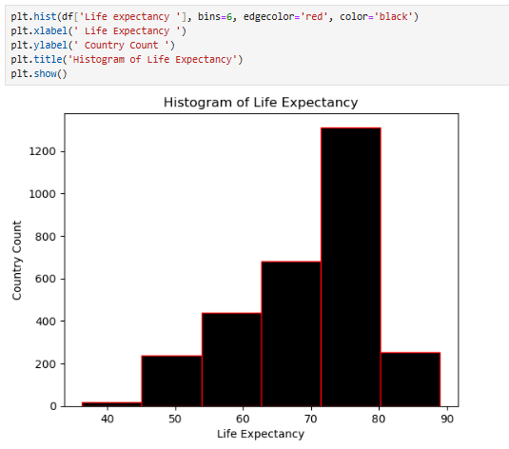
Univariate Analysis
Purpose:
To study the distribution and characteristics of each variable individually.
Helps detect skewness, central tendency, and outliers.
Life Expectancy: Most countries are between 60–75 years. Rich countries higher, poor countries lower.
Adult Mortality: Mostly low, but some countries show very high values.
Infant & Child Deaths: Very high in developing countries, almost zero in developed ones.
GDP: Few very rich countries, but most are low or middle income.
Schooling: Average is ~11 years. Higher in developed nations.
BMI: Normal overall, but a few extreme values (too low).
Immunization (Polio, Hepatitis B, Diphtheria): High (~100%) in developed countries, lower in developing ones.
Looking at each variable one by one to see its pattern (range, average, outliers).

Slide 13
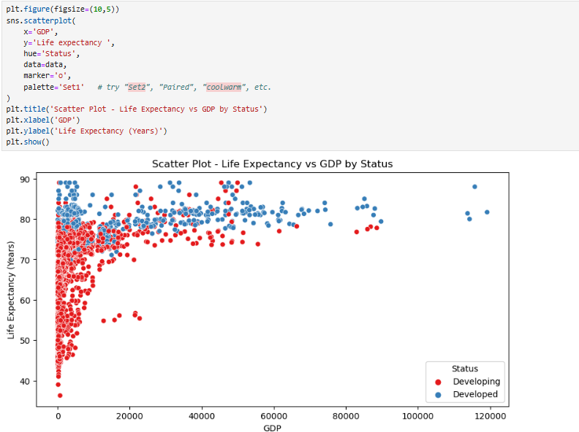
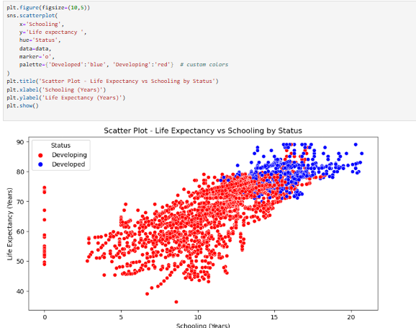
Bivariate Analysis
Studying the relationship between two variables at a time.
Helps us see how one factor affects or relates to Life Expectancy.
Key Relationships Observed:
GDP vs Life Expectancy
Strong positive correlation.
Countries with higher GDP per capita generally have longer life expectancy.
Developed countries form a cluster with both high GDP and long lifespan.
Schooling vs Life Expectancy
Strongest positive relationship.
More years of education → better awareness, health practices, and higher life expectancy.

Slide 14
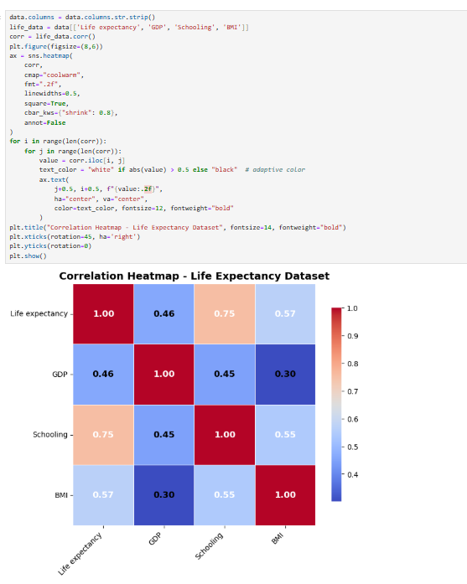
Multivariate Analysis
Studying the effect of multiple variables together on Life Expectancy.
Unlike univariate (one variable) or bivariate (two variables), multivariate gives a holistic picture
Techniques Used:
Correlation Heatmap
Showed relationships among all 22 variables at once.
Identified clusters of related factors (e.g., GDP ↔ Schooling ↔ Life Expectancy).
Pairplots (Scatter Matrix)
Allowed comparison of multiple variables (Life Expectancy vs GDP vs Schooling vs Mortality).
Clear separation between developed and developing countries.

Slide 15
Conclusion & Recommendations
Recommendations:
Education:
Increase years of schooling, especially for girls, as education strongly improves health outcomes.
Healthcare Investment:
Allocate more funds to healthcare infrastructure, hospitals, and preventive care.
Ensure equitable distribution of resources in rural and poor regions.
Immunization Programs:
Strengthen vaccination campaigns to cover diseases like Polio, Diphtheria, Hepatitis B.
Mortality Reduction:
Target maternal, infant, and adult mortality through improved healthcare access.
Expand maternal care, neonatal services, and awareness campaigns.
Disease Control:
Focus on reducing HIV/AIDS deaths through prevention, awareness, and treatment availability.
Conclusion:
The analysis showed that life expectancy varies widely between countries (30–90 years).
Developed countries consistently enjoy higher life expectancy due to:
Stronger economies (high GDP).
Better education (higher average years of schooling).
Wider healthcare access (high immunization coverage, higher health spending).

